Slide 1
Different Reconstruction Techniques on Sinogram Image
Rohit Das
Advised By – Prof. Chiou-Shann Fuh
61047086s@ntnu.edu.tw
+886-0905023713

Slide 2
Research progress
Filtered Back Projection (FBP)

Slide 3
Filtered Back Projection
FBP also known as Filtered Back Projection is an image reconstruction method widely used in X-ray CT.
Most commonly used reconstruction technique in cone beam CT.
As the name suggests, we apply a filter for removing the halo noise and apply Backprojection algorithm.
Since it is a linear method, we can also use the filter after implementing Backprojection.

Slide 4
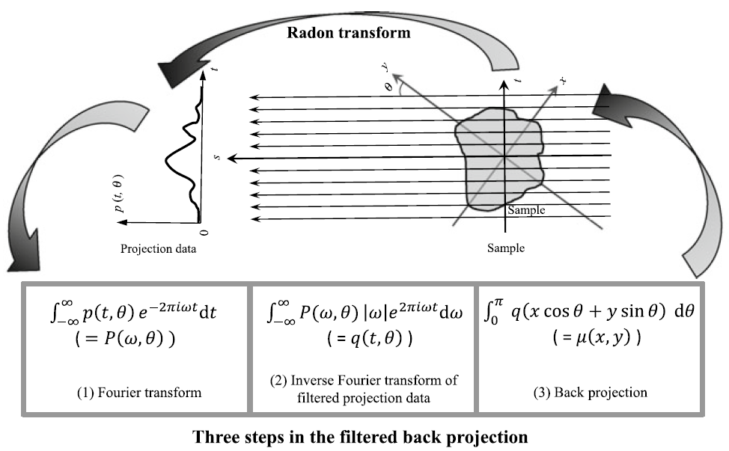
Filtered Back Projection

Slide 5

Steps of FBP
Original Image

Slide 6
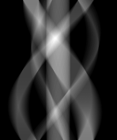


Steps of FBP
179$°$
0$°$
Sinogram
Create Sinogram using Radon Transform

Slide 7
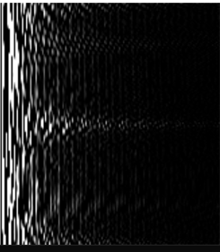
Steps of FBP
Forward Fourier Transform
Forward Fourier Transform for filtering the halo noise frequency

Slide 8
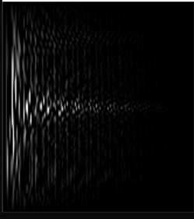
Steps of FBP
After applying Hamming Filter
High pass filter for better contrast
Hamming Filter
Ham Filter
Ram Filter
Cosine Filter
Shepp-Logan Filter

Slide 9

Steps of FBP
Inverse Fourier Transform
Applying Inverse Fourier Transform to reconstruct back to original state

Slide 10
Steps of FBP
Expected image after Backprojection
After Applying Backprojection algorithm

Slide 11
Challenge: Backprojection
Like any problem, there is a challenge!
The challenge we face right now is implementing Backprojection algorithm.
The actual process of backprojection is difficult to understand and an overview even less so.
Very hard to trace the process.
Since it is a linear operation and the process is dynamic and needs no static value, there might be a chance of different results on different images.

Slide 12
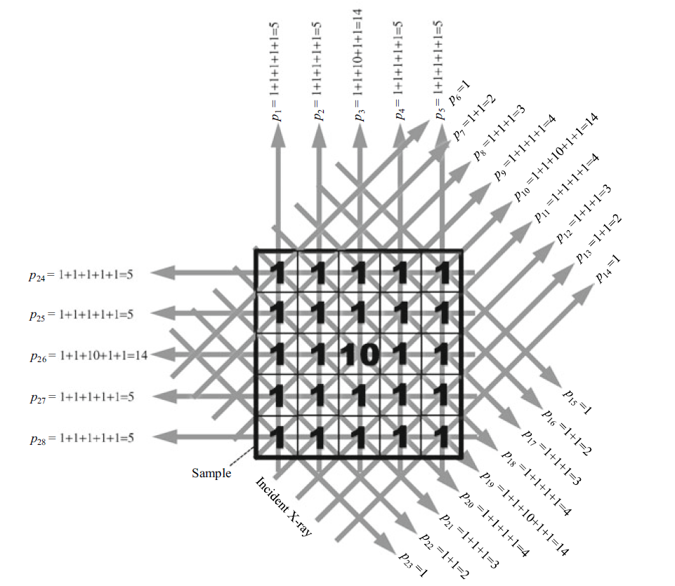
Challenge: Backprojection
Basic implementation for creating projection images

Slide 13
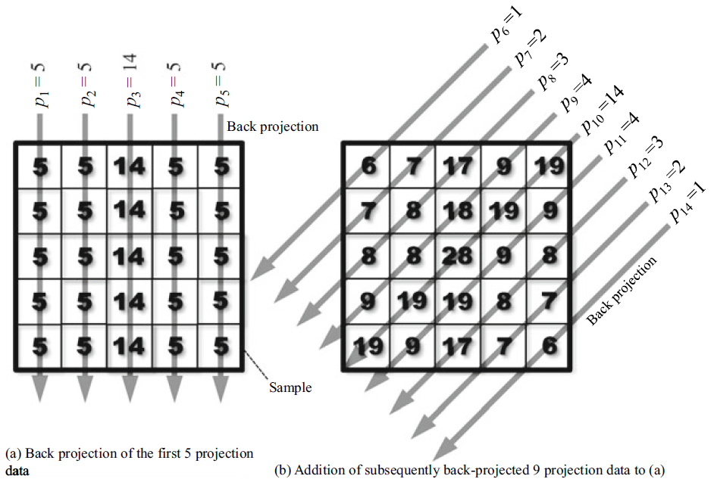
Challenge: Backprojection

Slide 14
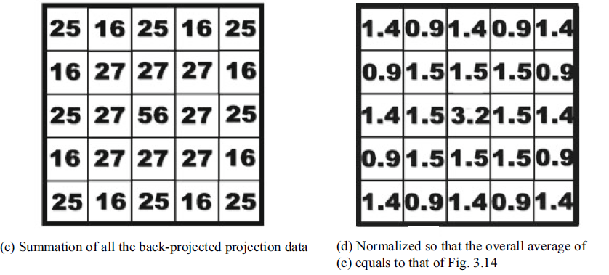
Challenge: Backprojection
equal to the previous picture

Slide 15
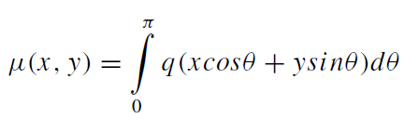
Challenge: Backprojection
Now there is a solution for implementing this algorithm efficiently:
$μ\left(x,y\right)$ = pixel co-ordinate
$q\left(x\cos{θ}+y\sin{θ}\right)dθ$ = Backprojection function

Slide 16
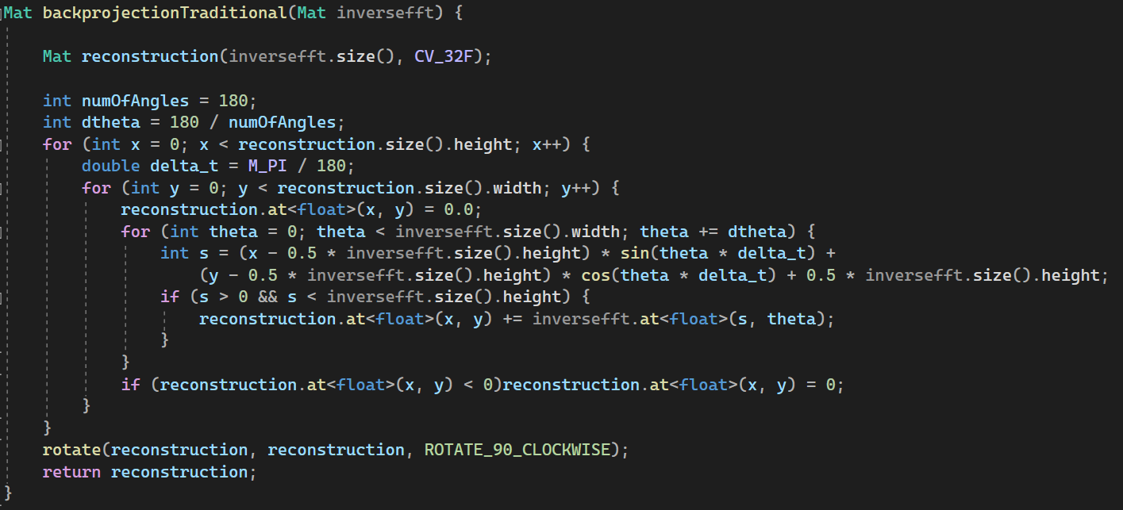
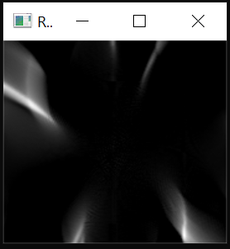
Results
After implementing the equation in code:
Result image after normalizing
Either it is opening up too much and there is too much loss of information.
Or it is using too less rotation to reconstruct it back.
Either way this is a wrong reconstruction

Slide 17
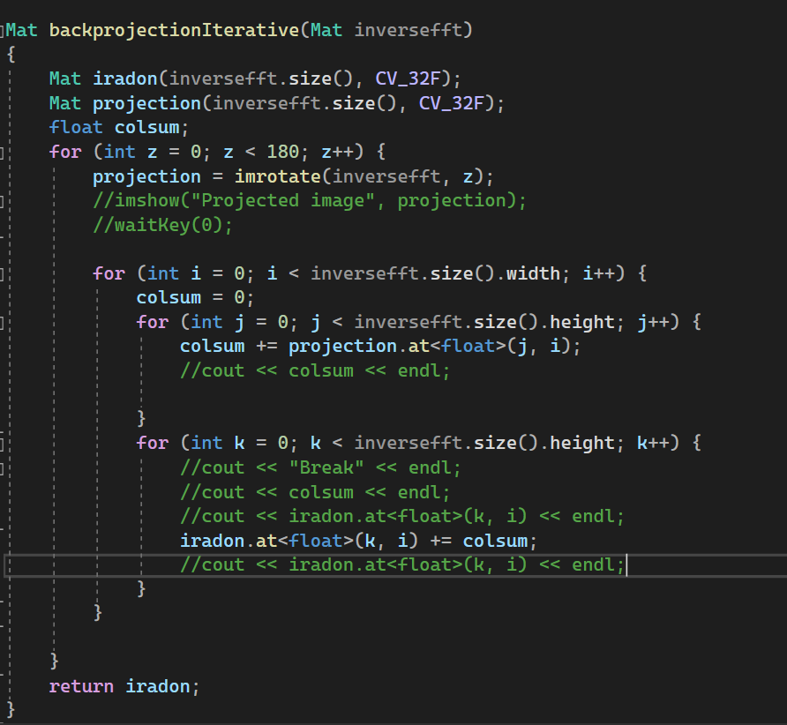
Results
After implementing the iterative way in code:
Result image after normalizing
For some reason the algorithm is not backprojecting clearly. (Open to Suggestions)
Also we lose some information at the top and bottom row.

Slide 18
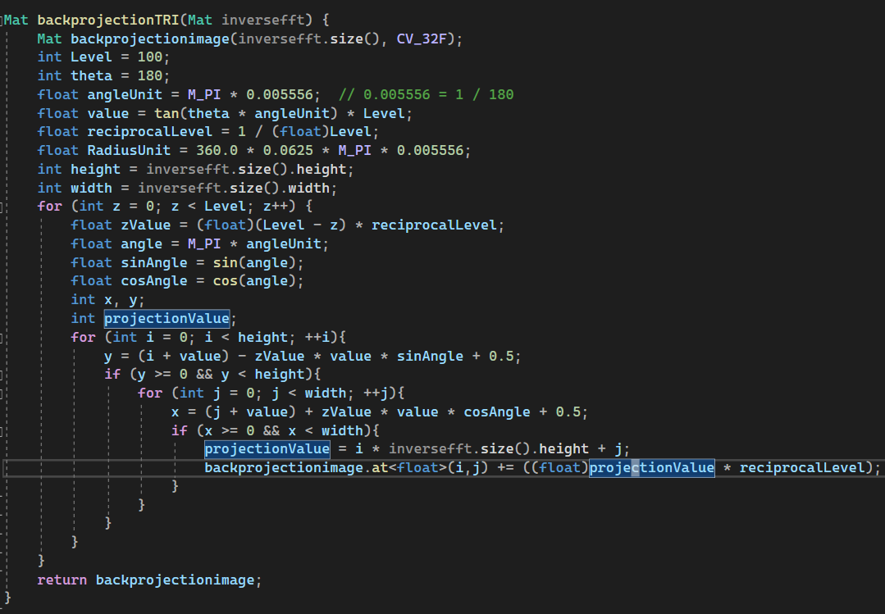

Results
After implementing the TRI code implemented previously by lab members:
Result image after normalizing
Though edited we believe this code is more suited for circuit board images.

Slide 19
Conclusion
FBP though easy is very tricky to implement.
MART and ART are better than FBP in implementation.
Because we can provide some prior information before implementing ART/MART.
For these kinds of problems, it is better to reconstruct based on prior information rather than implementing FBP which is totally linear operation .
The only place we can interfere in FBP is the filter which is also limited.
Ram Filter is best for FBP and so does other high pass filters but we believe we cannot totally remove the halo noise even after Fourier Transform because of Central Slice Theorem.
Did we mention that the projection is non-iterative!
FBP: Filtered back Projection
MART: Multiplicative Algebraic Reconstruction Technique
ART: Algebraic reconstruction Technique

Slide 20
Thank You!

